Slide 1
Week 2 (1) – Important Problem Types
CST370 – Design & Analysis of Algorithms
Dr. Byun
Computer Science

Slide 2
Lecture Objectives
After completion of this lecture, you will be able to
  recognize the importance of algorithms in computer science.
  identify important problem types in the algorithm class which include sorting, searching, graph problems, etc.

Slide 3
Chapter 1: Introduction
1.1 What is an Algorithm?
1.2 Fundamentals of Algorithmic Problem Solving
1.3 Important Problem Types
1.4 Fundamental Data Structures

Slide 4
Why study algorithms?
You can learn a set of standard algorithms in different computing areas.
You will be able to design a new algorithm to solve a new problem and analyze the efficiency of your algorithm.
It is the cornerstone of computer science.
  The computer program will not exist without the algorithm.
  It is also considered a common troubleshooting strategy.

Slide 5
Google Recruiter Email
The following list is a part of an email from a google recruiter regarding their interview questions.
  As you can see, many problems are about algorithms.
  Algorithm Complexity: You need to know Big-O. If you have difficulty analyzing the basic Big O complexity, you will rarely be hired.
  Sort: You should know how to sort.
  Hashtables: Probably the single most important single data structure known to mankind. ...
  Tree: ...
  Graph: ...
  Other data structures: As many different data structures and algorithms as possible should be studied.
  …

Slide 6
Basic Issues Related to Algorithms
How to design algorithms
How to analyze algorithm efficiency
Proving correctness
Optimality

Slide 7
<<< Course Instruction >>>
Before going on to the next topic, read pages 9-16 of the textbook.
  Note that this is “optional reading”.
  If you want to skip, you can skip it. However, I encourage you to read this section.

Slide 8
Algorithm Design and Analysis Process
An algorithm is a procedural solution to a problem.
  An algorithm is specific instructions for getting an answer.
There is a sequence of steps one typically goes through in designing and analyzing an algorithm.

Slide 9
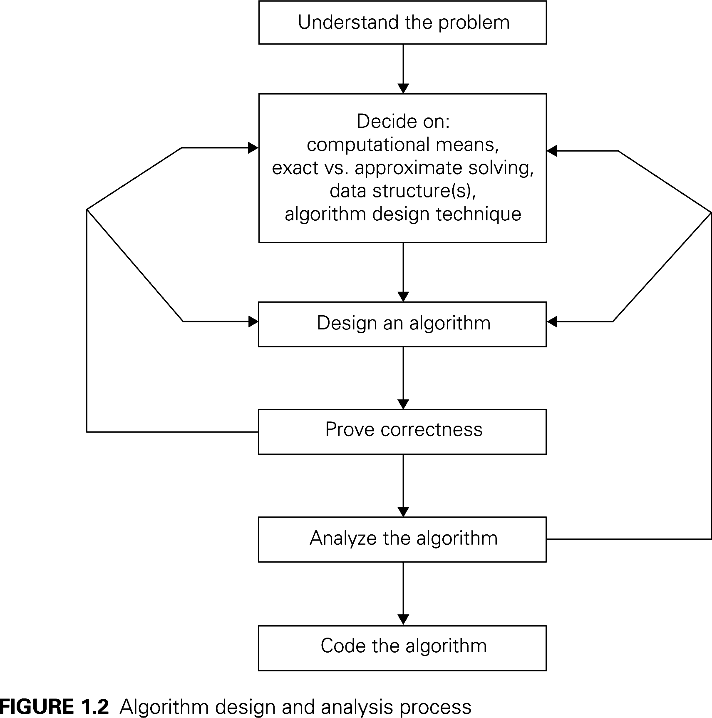

Slide 10
Algorithm Design and Analysis Process
Understanding Problem
  There are a few types of problems that are arise in applications quite often.
  Example: sorting, searching, string matching, etc.
Ascertaining Capabilities of a Computational Device
  Typically von Neumann machine
  Sequential algorithms vs. parallel algorithms
Deciding an Appropriate Data Structures
  Example: list, stack, queue, tree, etc.
Methods of Specifying Algorithms
  English, pseudocode, flowchart

Slide 11
Chapter 1: Introduction
1.1 What is an Algorithm?
1.2 Fundamentals of Algorithmic Problem Solving
1.3 Important Problem Types
1.4 Fundamental Data Structures

Slide 12
Important Problem Types
Sorting
Searching
String processing
Graph problems
Combinatorial problems
Geometric problems
Numerical problems

Slide 13
<<< Course Instruction >>>
You must read pages 18 through 23 of the textbook.
  This section introduces the most important problem types in algorithms.
  These problems are used in subsequent chapters of the book to illustrate different algorithm design techniques and methods of algorithm analysis.

Slide 14
Terminology – Stable Sorting
You must know the concept of “stable sorting”.
  A sorting algorithm is said to be stable if two objects with equal keys appear in the same order in sorted output as they appear in the input unsorted array.
  Some sorting algorithms are stable like Insertion sort, Merge Sort, Bubble Sort, etc. And some sorting algorithms are not, like Heap Sort, Quick Sort, etc.
  https://en.wikipedia.org/wiki/Sorting_algorithm#Stability

Slide 15
In-Place Sorting Algorithm
An algorithm is said to be in-place if it does not require extra memory, except, possibly, for a few memory units.
  There are important sorting algorithms that are in-place and those that are not.

Slide 16
Traveling Salesman Problem (TSP)
It is one of the best known graph problems in computer science.
The travelling salesman problem (TSP) asks the following question: "Given a list of cities and the distances between each pair of cities, what is the shortest possible route that visits each city exactly once and returns to the origin city?"

Slide 17
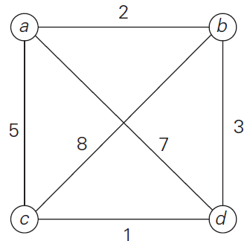
TSP Example
Assume that you start a traversal for the following graph from the node a.
  What is the optimal travel path and travel cost?

Slide 18
TSP Example – Solution
There are two optimal paths (or tours)
  a → b → d → c → a
  a → c → d → b → a
The travel cost will be 11.

Slide 19
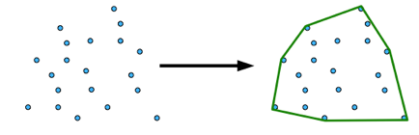
Convex-Hull Problem
Convex hull
  Given a set of N points in the plane, find the minimum area convex area that contains all the points.
Example
  http://axon.cs.byu.edu/Dan/312/projects/ConvexHull.php

Slide 20
Puzzle: Three mislabeled baskets
Suppose that there are three baskets on a desk.
  One basket contains an apple, another basket contains an orange, and the last basket contains an apple and an orange.
Now, let's assume that each basket has a label outside like “Apple”, “Orange”, or “Mix”.
  The problem is that the labels are always mislabeled. For example, if the label says “Mix”, you can be sure that the basket is never actually a blend of an apple and an orange, i.e. it actually contains either an apple or an orange.
In this puzzle you can choose only one basket to see what is in it. Which basket should you choose to label all three properly?

Slide 21
Important Note
Do not see the answer immediately on the next page.
  If you do, you will not get any knowledge from this puzzle.

Slide 22
Solution
You can solve this problem by selecting any basket.
  Think about why.

Slide 23
<<< Course Instruction >>>
This lesson is over.
  If you do not understand any part in the lecture, study it again.
When you are done, study the next lecture (week_2_2.ppt) on the iLearn.

